Slide 1
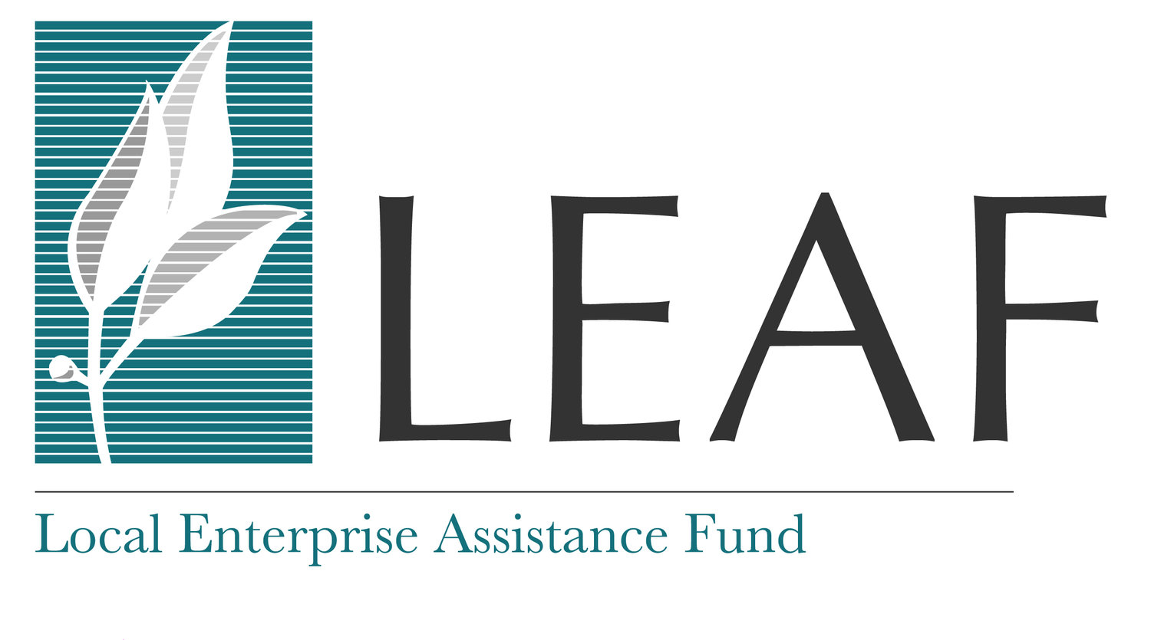

Slide 2
FY 2020 at a Glance
15 Projects Funded
Over 127,000 Individuals with Improved/Expanded Access
230 Jobs Created or Retained
Representation of Minority Enterprise Owners
6 out of the 15 projects are owned or substantially controlled by a Person of Color
9 out of the 15 projects are owned or substantially controlled by a woman
91% of Workers Hired from Within the Local Community
Average Wage of $14/hr
100% of Projects Accept or Will Accept SNAP & WIC
Notes:
Leveraged $4.4 million in total project costs

Slide 3
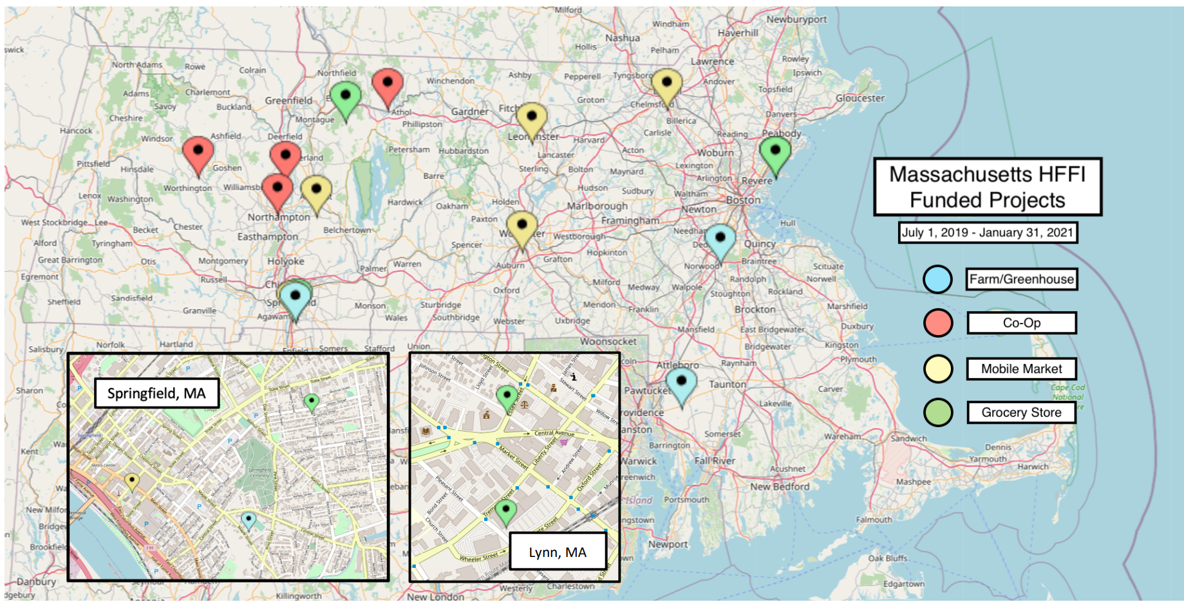
Funded Projects Across the State FY 2020

Slide 4
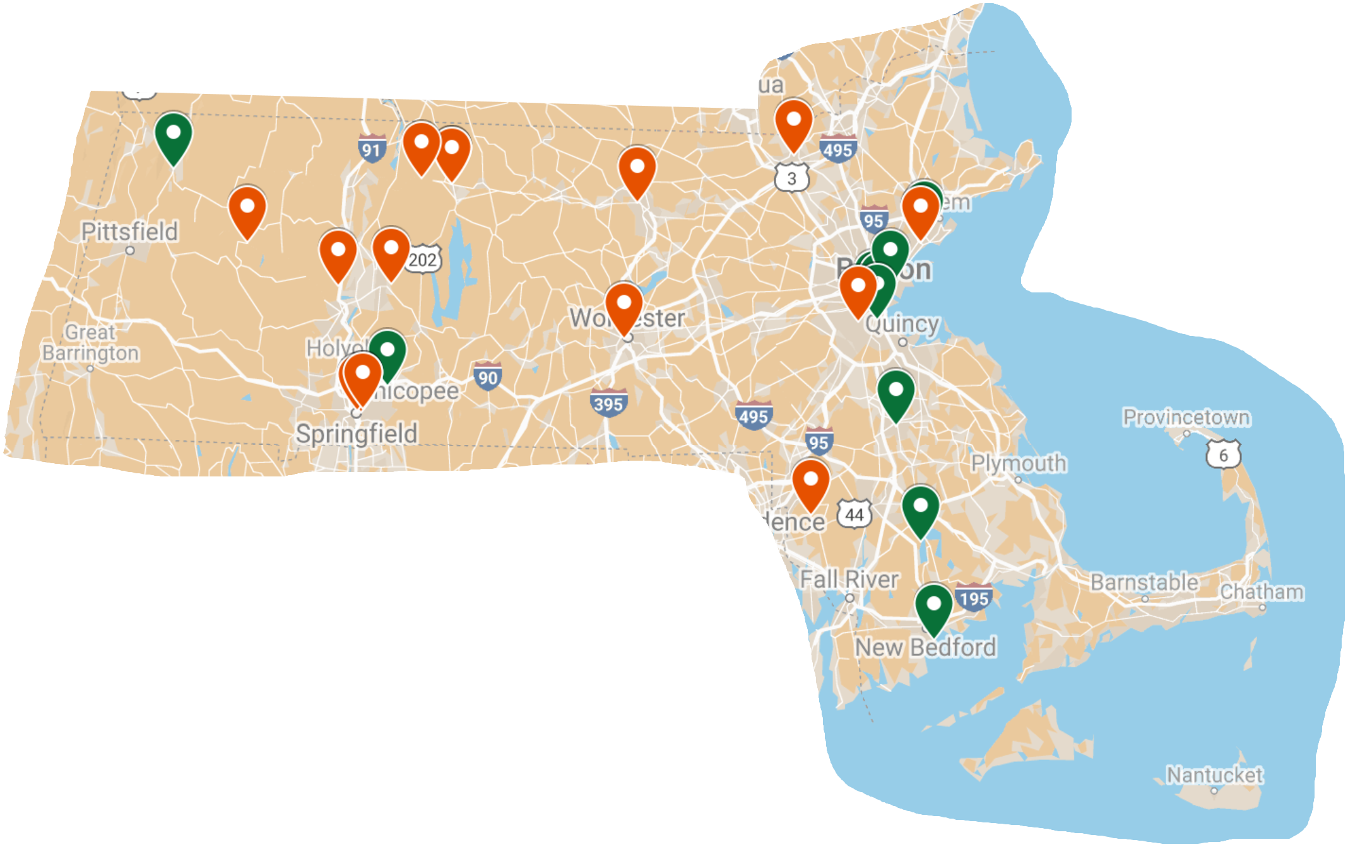
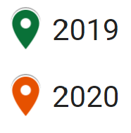
Funded Projects Across the State FY 2019 to FY 2020
27 Projects Funded
10 Counties Served
Over 211,000 Individuals with expanded healthy food access
$2 million in MFTP funds leveraged $8.5 million in total project costs
Click here for Google Map with underlying details

Slide 5
FY 2019 and FY 2020 at a Glance
27 Projects Funded (25 Unique Retailers/Organizations)
Over 211,000 Individuals with Improved/Expanded Access
Over 558 Jobs Created or Retained
Representation of Minority Enterprise Owners
10 out of the 25 unique retailers are owned or substantially controlled by a Person of Color
15 out of the 25 unique retailers are owned or substantially controlled by a woman
93% of Workers Hired from Within the Local Community
Average Wage of $15/hr
100% of Projects Accept or Will Accept SNAP & WIC
Notes:
Leveraged $8.5 million in total project costs

Slide 6
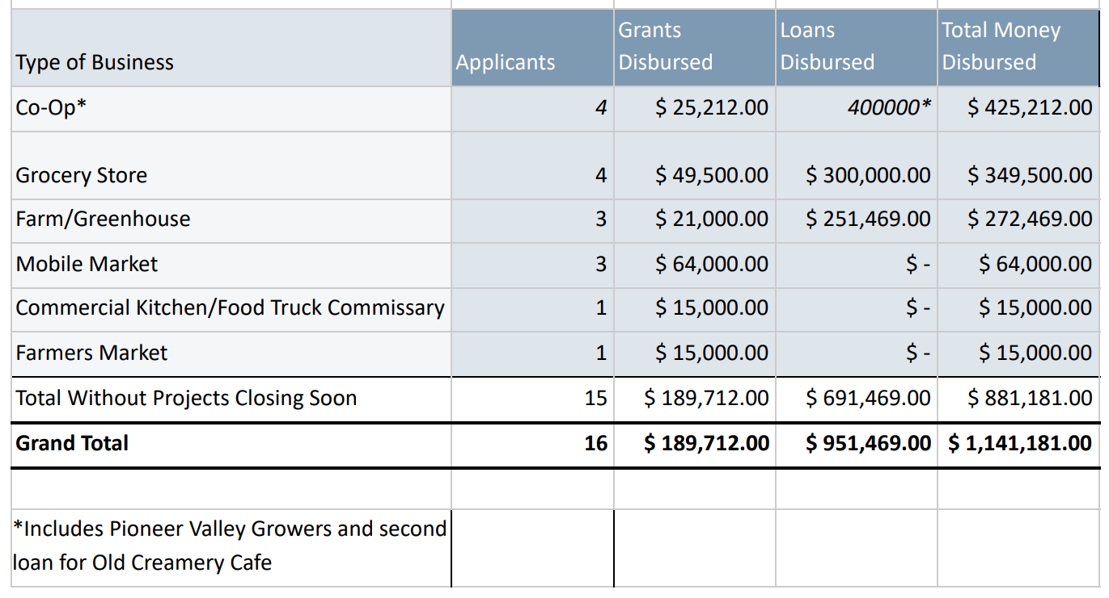
Funding by Type of Industry
FY 2019
FY 2020
Notes:
LEAF recently received $1 million in HHFI funds from the CDFI. Looking to deploy as much as possible in Mass.

Slide 7
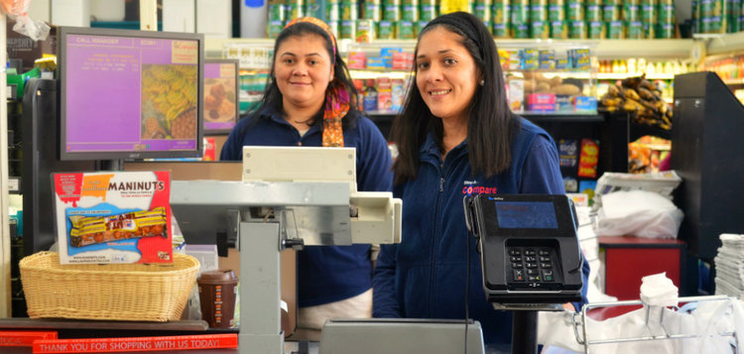
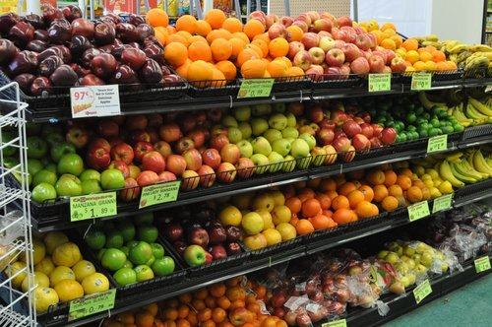
Stop and Compare Market
Lynn, MA
Opening new location in Lynn Market Place; MFTP part of financing package.
The market prioritizes the hiring of diverse workers living within the Lynn community.
Stop and Compare Market intentionally engages in local efforts and coalitions. The store is part of the local Latino associations, and continuously strives to meet the community’s needs and expectations.
Notes:
$300K MFTP Loan, part of $1.8 million financing package.

Slide 8
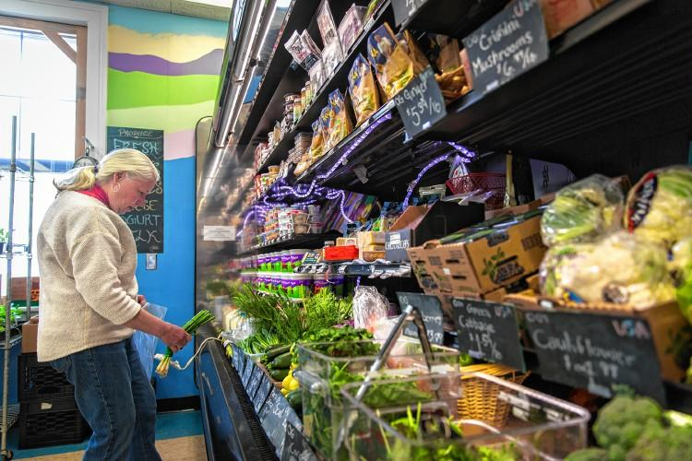
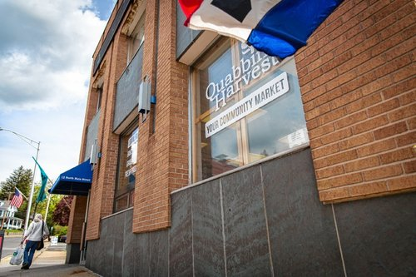
Quabbin Harvest
Orange, MA
Food Co-op raised more funding from members to expand; MFTP matched amount.
As the only retail location within a 1.3 mile radius able to provide fresh food, Quabbin Harvest is the only place to buy fresh, and often local, produce that is within walking distance of downtown Orange.
Quabbin Harvest was named as the top enroller of HIP customers in the state, serving nearly 140 families at peak enrollment.

Slide 9
Ernie's Harvest Time & The Food Project
Lynn, MA
Ernie’s Harvest Time is an existing small market in downtown Lynn. Looking to improve the store’s capacity to stock fresh, local, culturally-relevant produce, and to distribute this produce to other local retail stores.
The Food Project’s youth, staff, and volunteers grow 150,000 pounds of food each year on their farms and operate farmers markets in Boston’s Dudley neighborhood and in Lynn
Actively engage neighborhood residents in Boston’s Dudley neighborhood and in the city of Lynn to articulate their vision for their food systems.

Slide 10
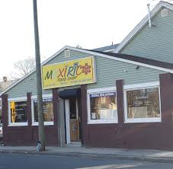
MexiRico
Springfield, MA
Impacted by COVID-19, sought emergency grant
Serves a culturally diverse, lower-income community that is dependent upon a single supermarket which was described as not adequately meeting community’s needs in the community fit research for the Develop Springfield project.
MexiRico’s staff aims to provide the community with culturally relevant products that are fresh and affordably priced while creating a welcoming, safe community space.

Slide 11
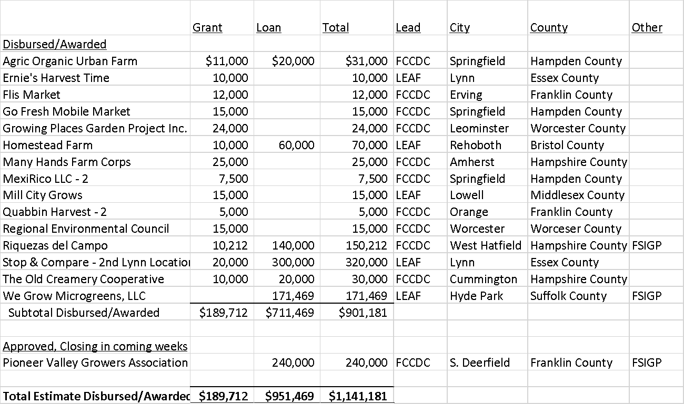
FY 2020 Overview of Funding
17% Grants | 83% Loans
Maximizing Impact and Sustainability
Notes:
Leveraged $4.4 million in total project costs in 2020 and $8.5 million for 2019 and 2020.

Slide 12
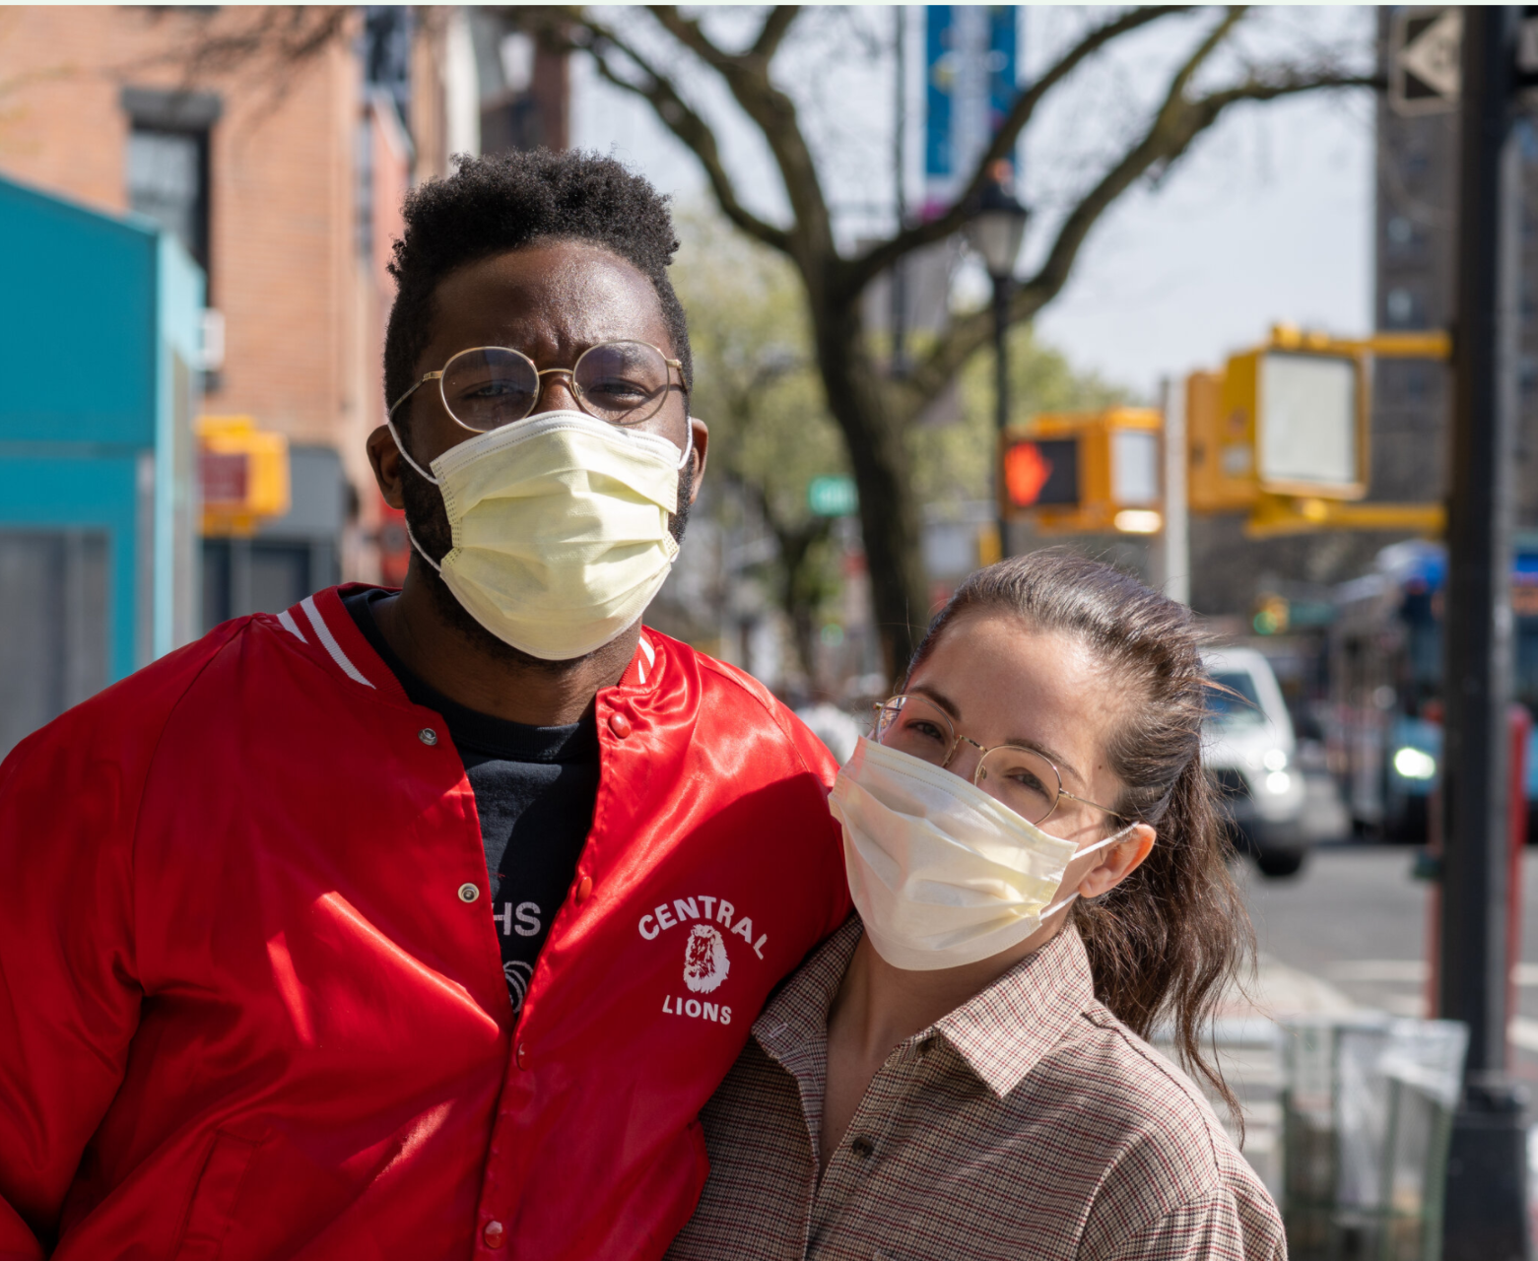
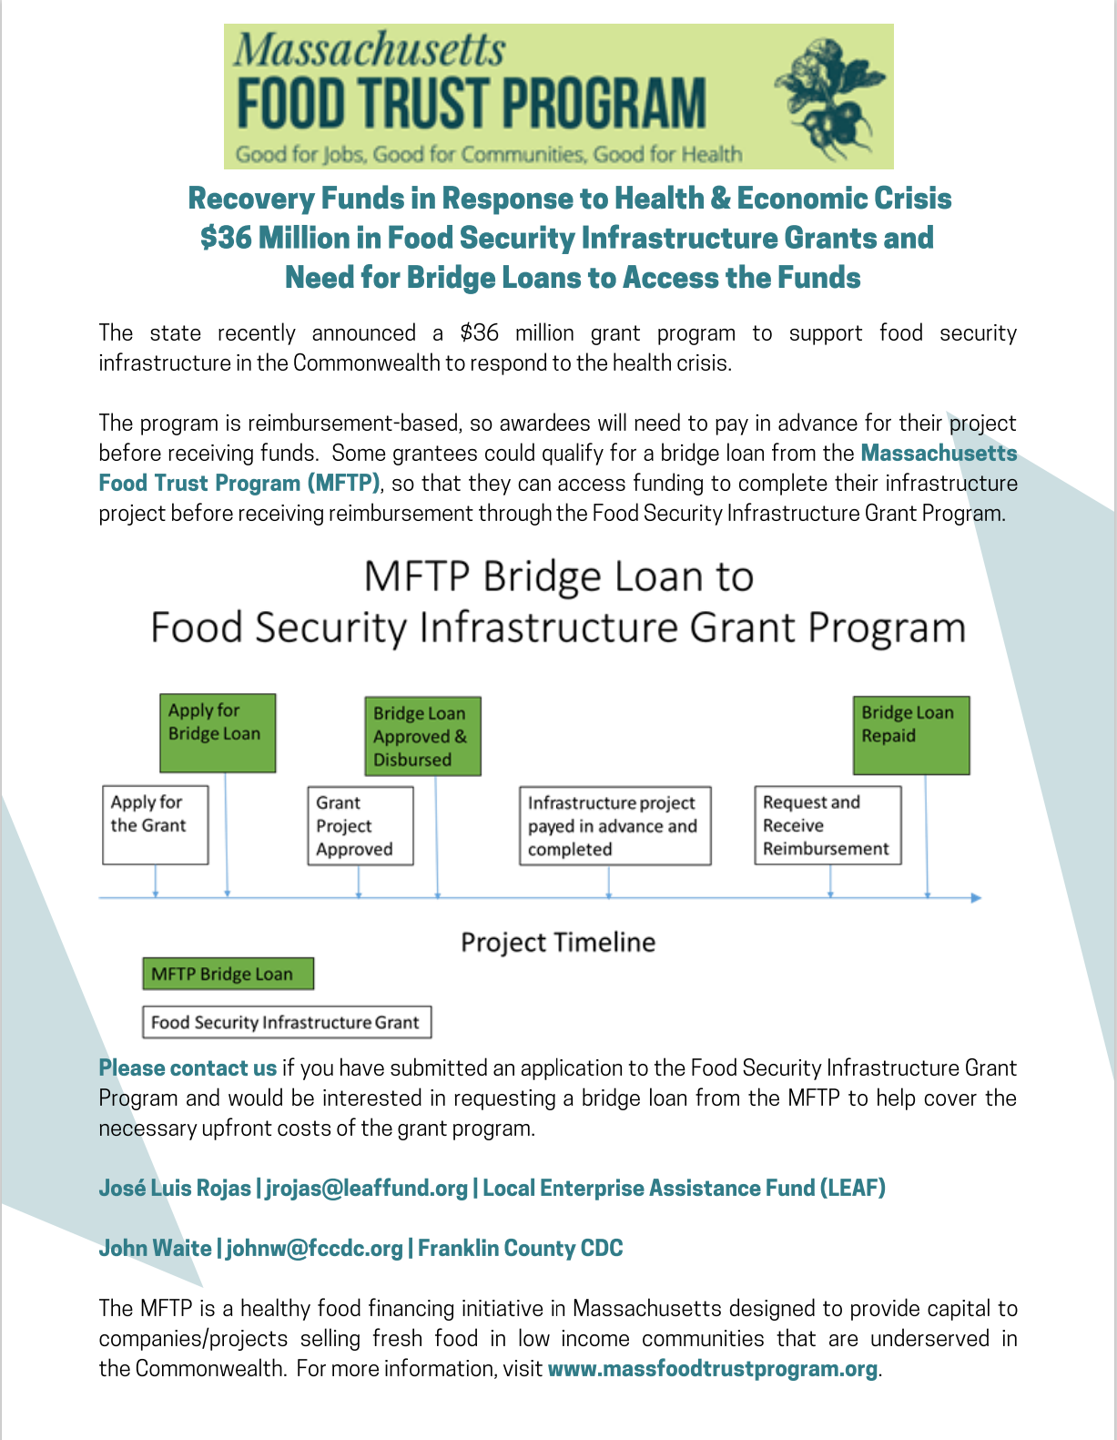
Response to Covid-19
Payment moratoriums and interest-only periods to existing customers
Small emergency grants
Recovery funds at 0% interest for 6-12 months
Bridge loans to FSIGP projects

Slide 13
MFTP Revolving Principal & Tracking of Past Projects Through 2/1/2021
LEAF MFTP Borrowers
Total Principal Revolved: $57,737
FCCDC MFTP Borrowers
Total Principal Revolved: $271,086
MFTP loans often have included interest-only periods
Program is still new, so have not reached point where significant principal has been paid down
Implemented 6-month check-ins and annual monitoring of past projects

Slide 14
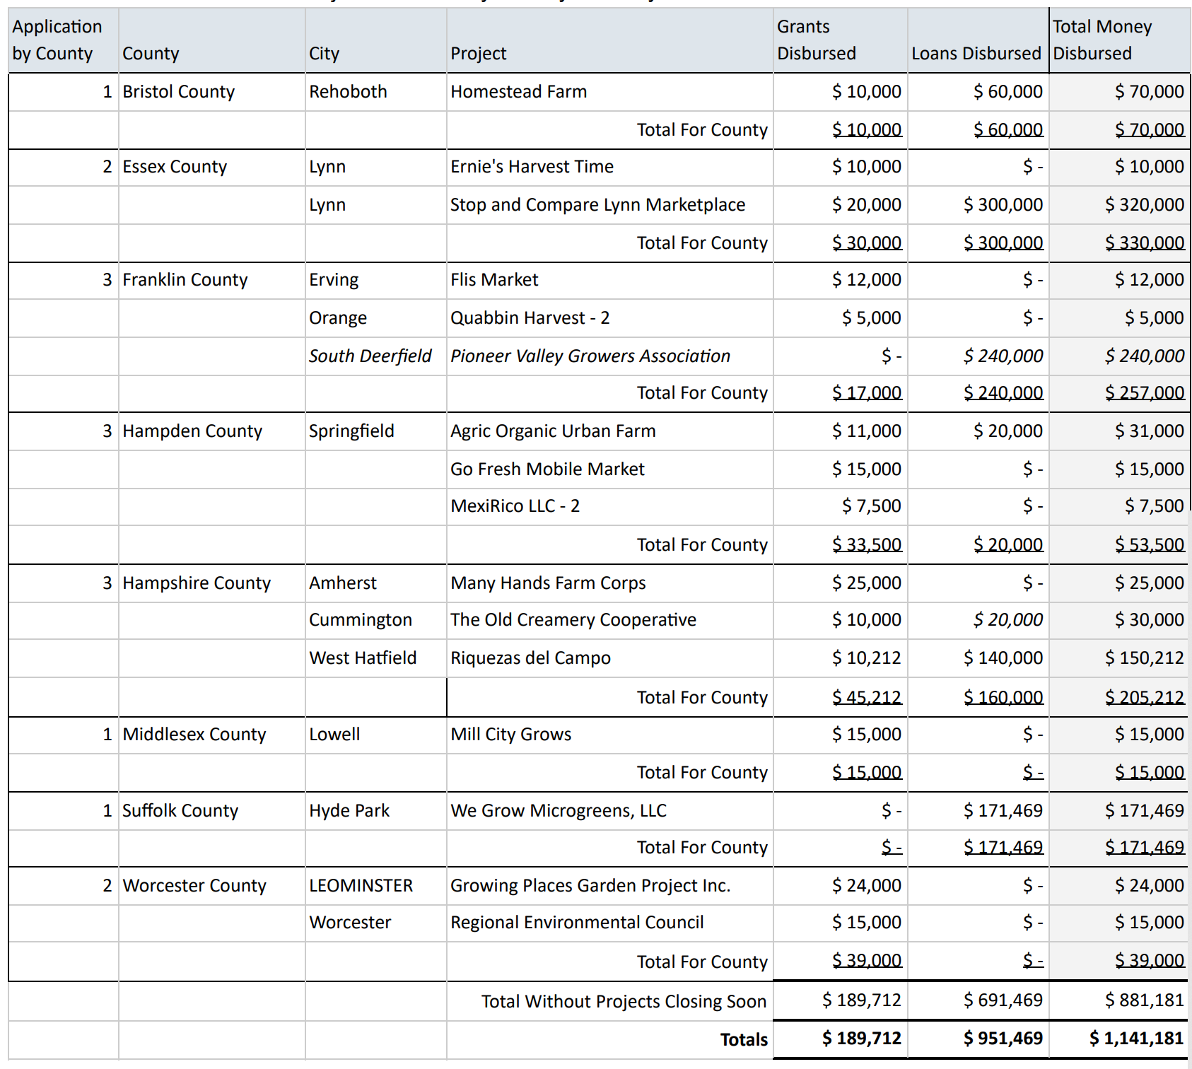
FY 2020 Overview of Funding by County
Notes:
Leveraged $4.4 million in total project costs in 2020 and $8.5 million for 2019 and 2020.

